Slide 1


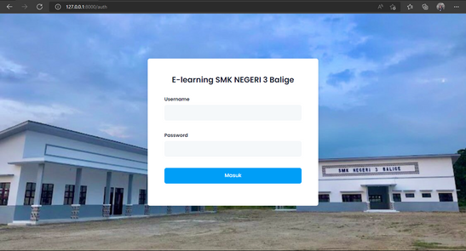
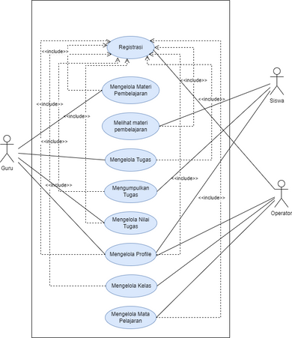


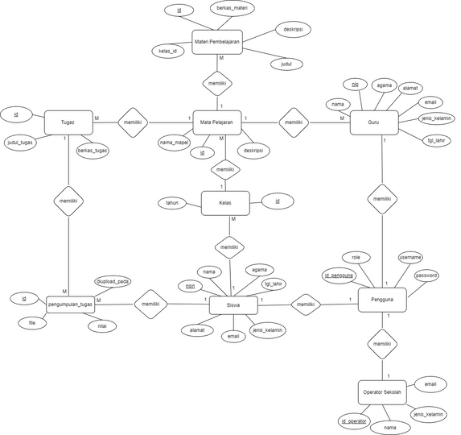


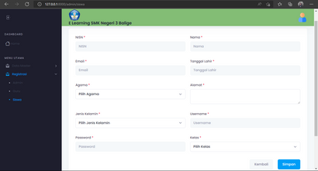
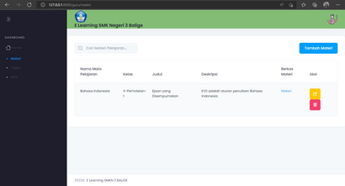

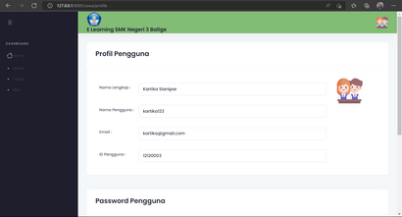
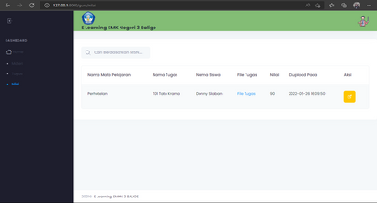
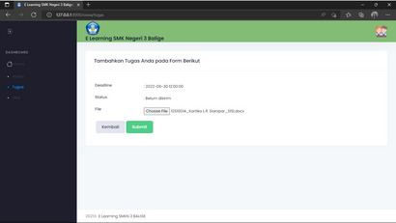
SILEBA
Fakultas Informatika dan Teknik Elektro
Pembangunan Sistem E-Learning
SMKN 3 Balige berbasis web
Sistem Informasi
PSI-22-02
Functional Requirement
Non-Functional
Requirement
Background
During this pandemic, SMK Negeri 3 Balige using Whatsapp and Google Classroom as online learning media. The use of diverse platforms like this makes students, teachers and school staff overwhelmed because they have to adapt to each other systems. To deal with these problems, we built a SMK Negeri 3 Balige E-Learning System where this system will integrate every business process that can be done to support the teaching and learning process at SMK Negeri 3 Balige.
Security
Response Time
Ergonomy
Accessibility
Database Design
Purpose
Guru
Operator
Siswa
E-Learning will facilitate interaction between students and teachers in the teaching and learning process
Teachers can deliver additional material or supporting materials through online learning.
Students can also collect assignments more effectively and efficiently by having time limits and learning information becomes more accessible to students.
Website System
Registration
Login
Manage Materi Pembelajaran
Manage Tugas
Manage Profile
Manage Nilai
Collect Tugas

